Slide 1
Updates for Cargill 6/09/20

Slide 2
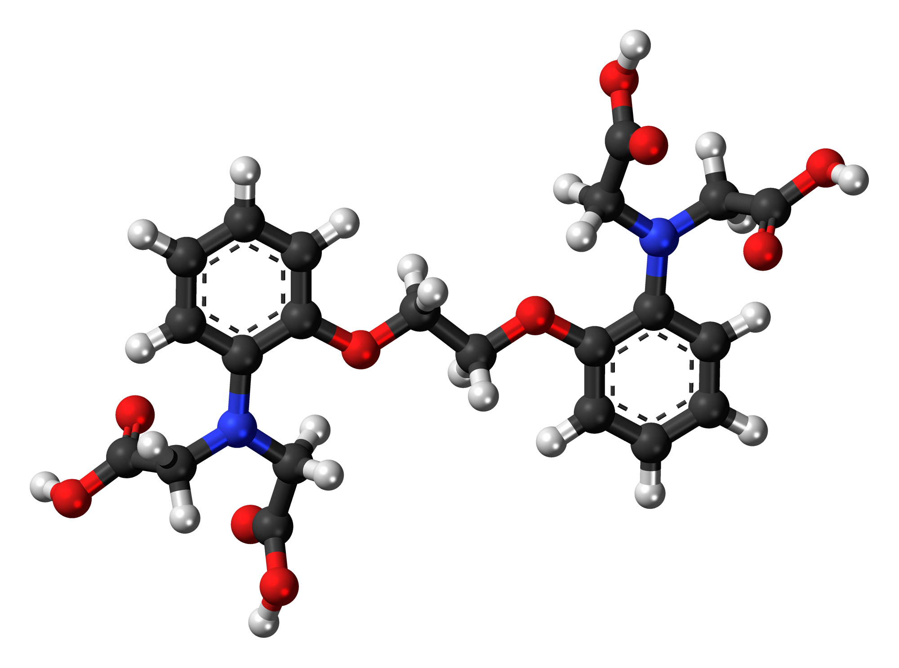
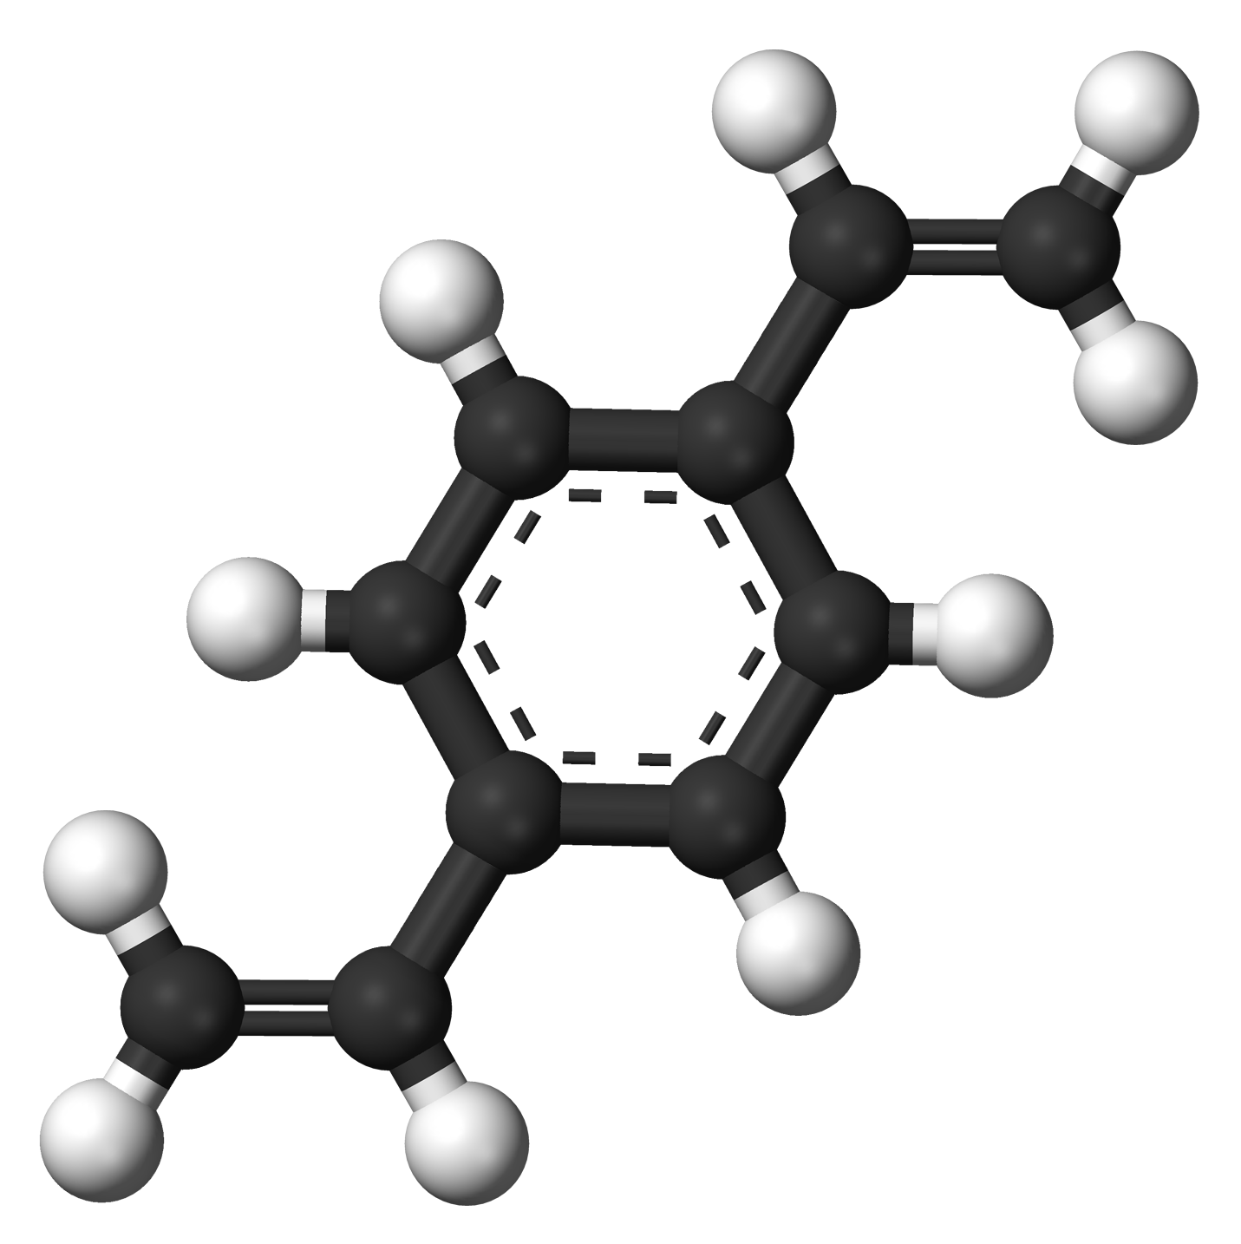
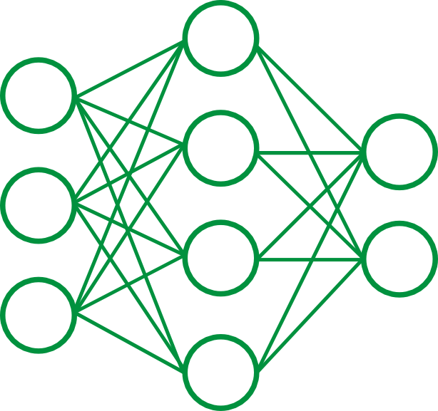

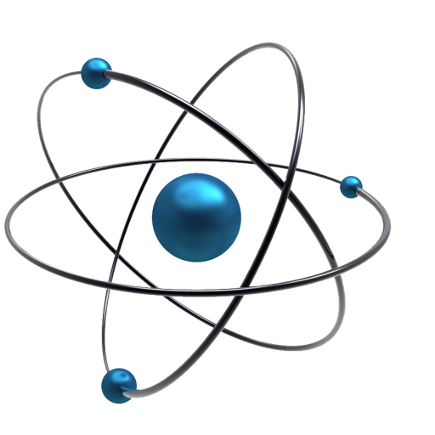
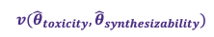
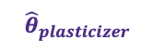
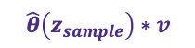
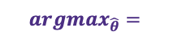
Proposed Learning Pipeline
Molecular Generation
$${argmax}_{\hat{θ}}=$$
Decoder
Reconstructed
SMILES
Encoder
SMILES
Feature Gen
Property
Predictor
$$v({\hat{θ}}_{toxicity},{\hat{θ}}_{synthesizability})$$
$${\hat{θ}}_{plasticizer}$$
$$\hat{θ}\left(z_{sample}\right)∗v$$

Slide 3
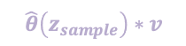
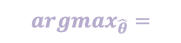

Proposed Learning Pipeline
Molecular Generation
$${argmax}_{\hat{θ}}=$$
Decoder
Reconstructed
SMILES
Encoder
SMILES
Property
Predictor
$$v({\hat{θ}}_{toxicity},{\hat{θ}}_{synthesizability})$$
$${\hat{θ}}_{plasticizer}$$
$$\hat{θ}\left(z_{sample}\right)∗v$$

Slide 4

Proposed Learning Pipeline
Molecular Generation
$${argmax}_{\hat{θ}}=$$
Decoder
Reconstructed
SMILES
Encoder
SMILES
Property
Predictor
$$v({\hat{θ}}_{toxicity},{\hat{θ}}_{synthesizability})$$
$${\hat{θ}}_{plasticizer}$$
$$\hat{θ}\left(z_{sample}\right)∗v$$

Slide 5
Feature Selection
Training the model for different reg_params

Slide 6
Feature Selection

Slide 7
Feature Selection
We started with 195 features for organics and plasticizers.
After training the model with the nonzero coefficients, we obtained 15 features with optimized plasticizers and organics accuracies
PEOE_VSA13 PEOE_VSA9 SMR_VSA9
SlogP_VSA8 EState_VSA1 VSA_EState1
NumHeteroatoms NumRotatableBonds fr_Al_OH_noTert
fr_COO fr_aldehyde fr_benzene
fr_methoxy fr_ester fr_quatN

Slide 8
Building the VAE
Overview
Loss Function
Model Architecture

Slide 9
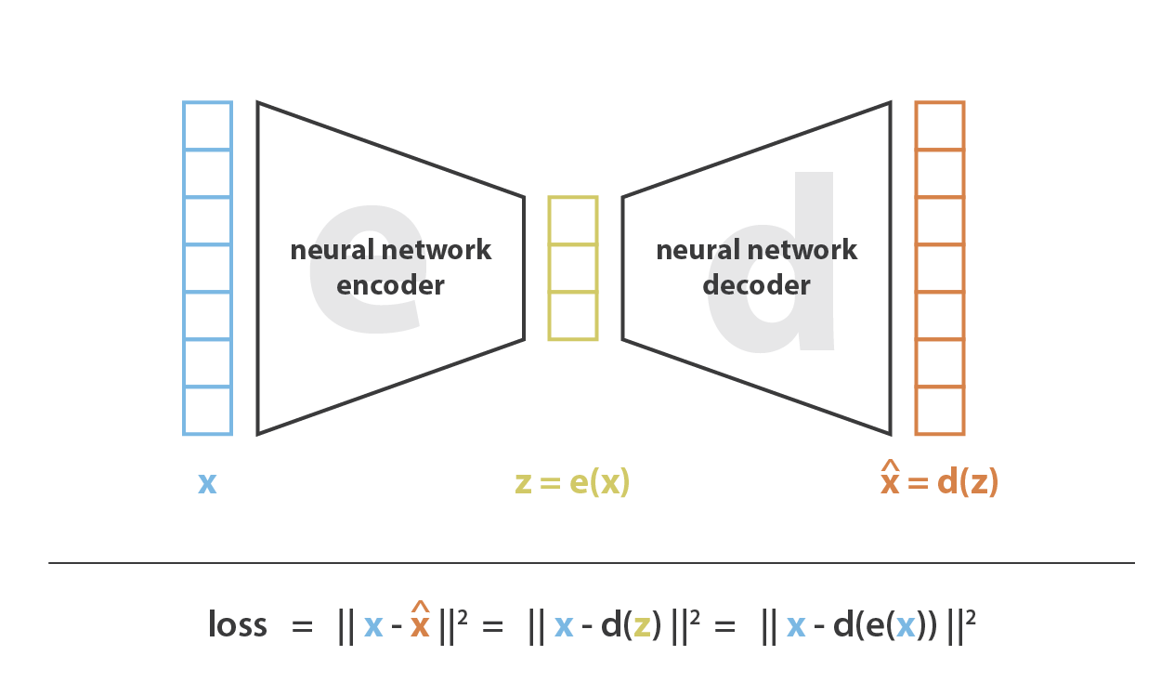
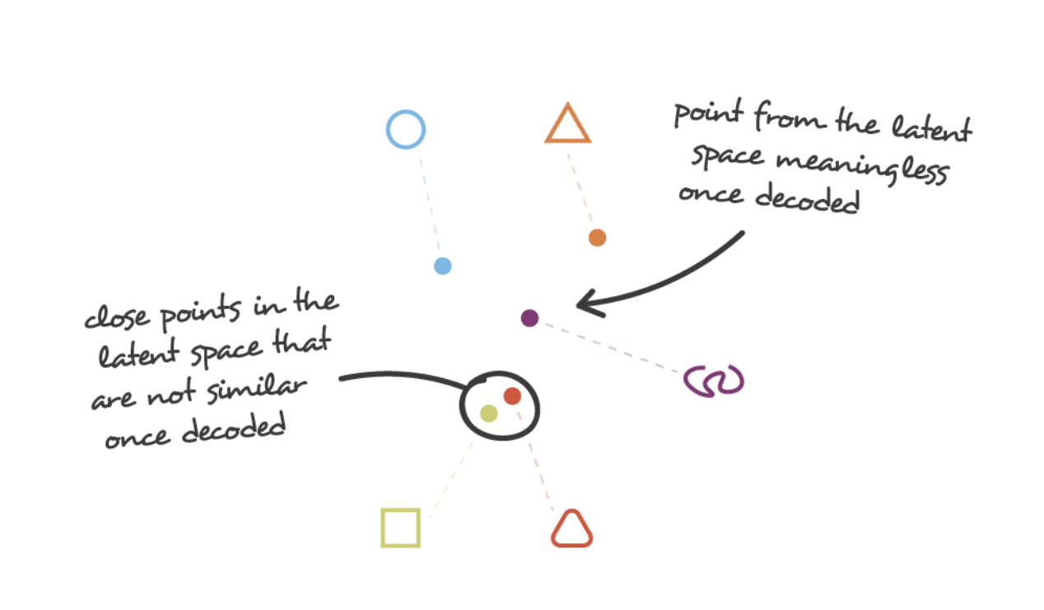
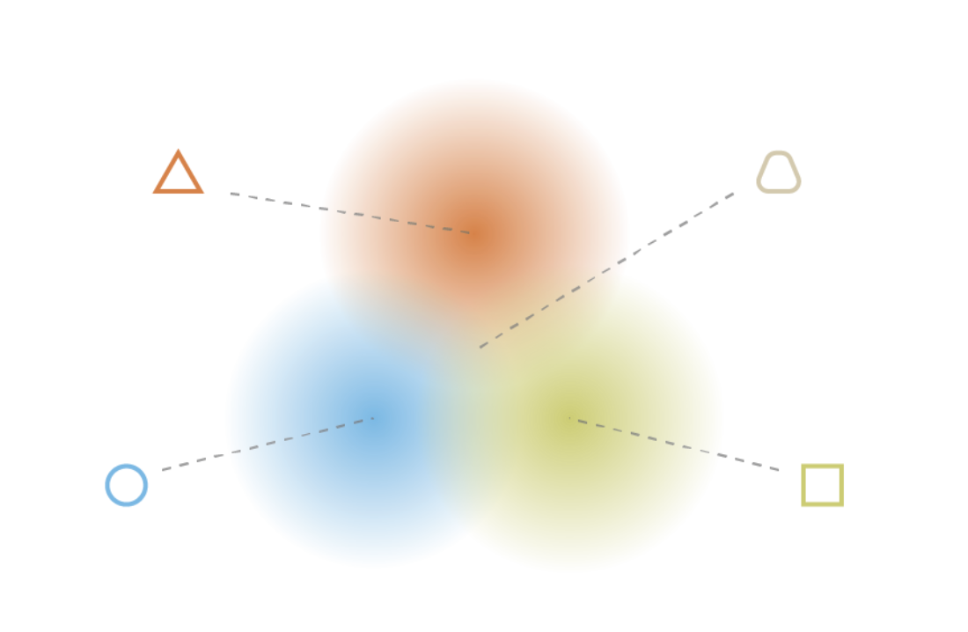
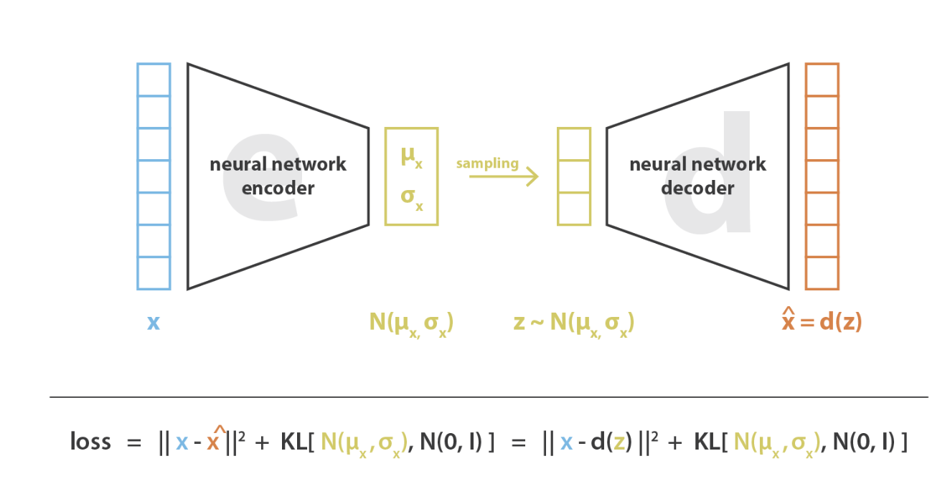
Why Use a Variational Autoencoder?
Autoencoder
Encoder-decoder networks (especially those with deep architectures) can easily be overfit
Variational Autoencoder
Enforcing standard distribution (KL divergence term) keeps data tightly clustered and allows for overlap between known points

Slide 10
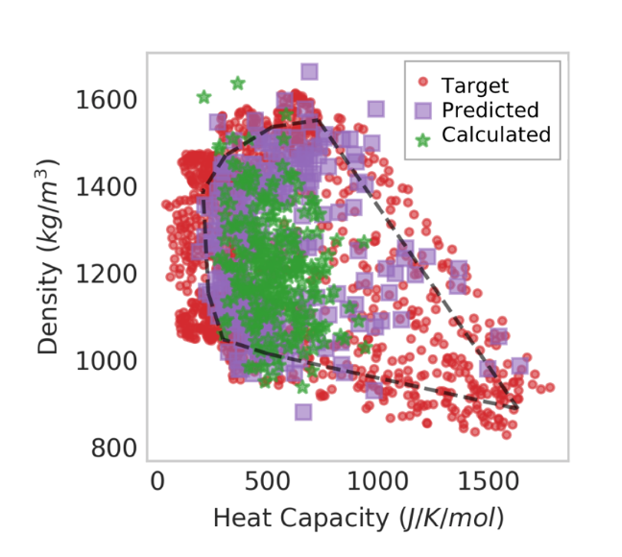
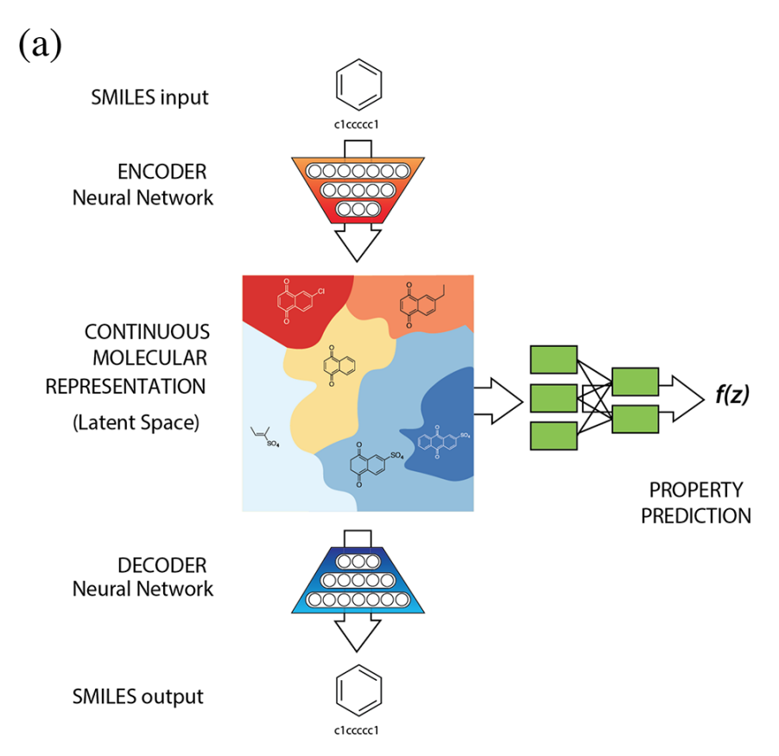
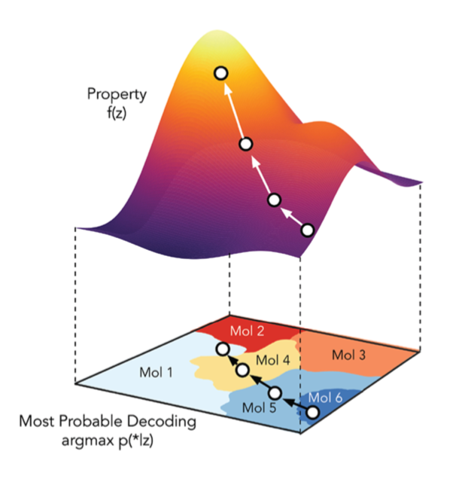
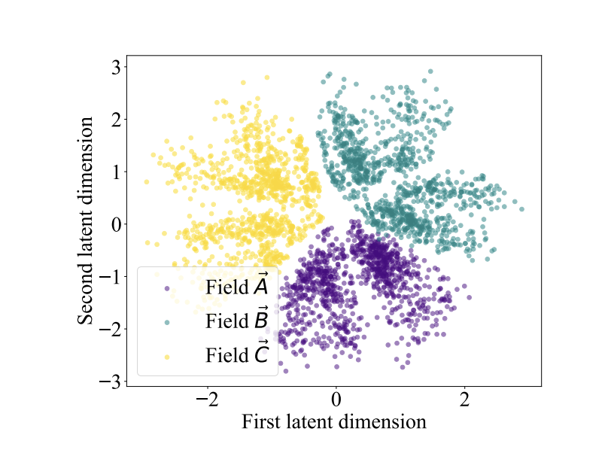
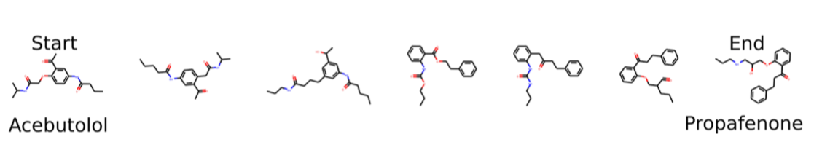
From Latent Space to Reality
Breaking the Pareto front (Beckner)
Continuous representation of molecular structures (Aspuru-Guzik)
https://doi.org/10.1021/acs.jcim.9b00087
Learning thermodynamics (Zhong)
https://doi.org/10.1021/acscentsci.7b00572
https://arxiv.org/pdf/2004.03604.pdf

Slide 11
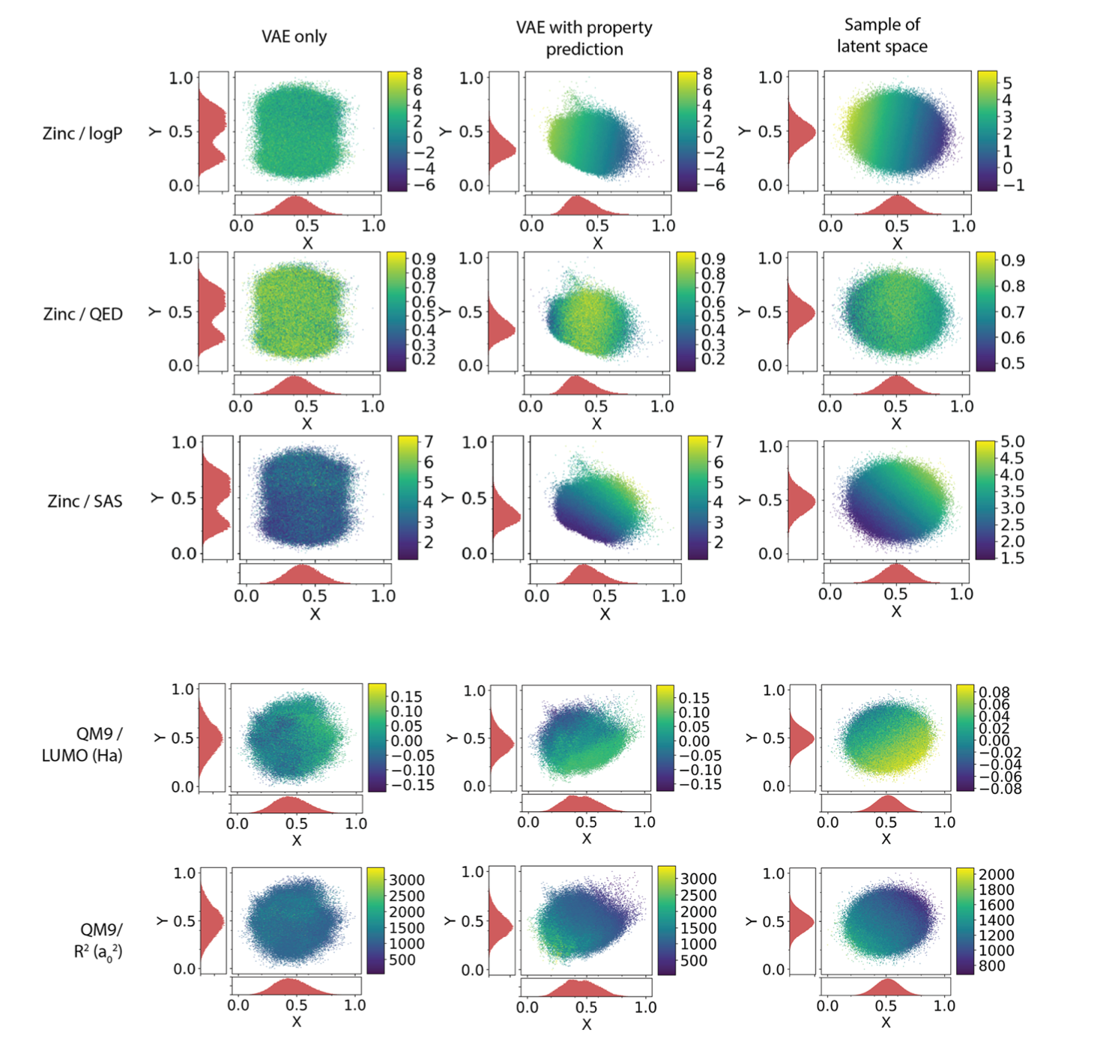
From Latent Space to Reality
Property predictions using VAE w/QSPR on Zinc and QM9 databases
Breaking the Pareto front (Beckner)
Continuous representation of molecular structures (Aspuru-Guzik)
Learning thermodynamics (Zhong)
https://arxiv.org/pdf/2004.03604.pdf

Slide 12
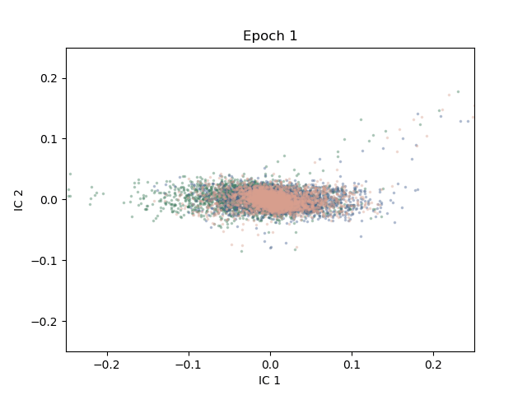
Real-time Reorganization
As the neural net learns, latent space organizes itself into distinct domains
This example shows a 3d convolutional neural net learning protein structural domains

Slide 13
Evaluating the Loss Function
$$Loss=Reconstruction+KL Divergence+Property Prediction$$

Slide 14
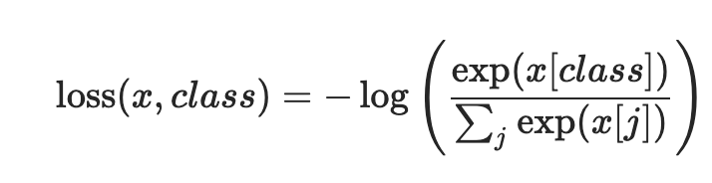
Evaluating the Loss Function
$$Loss=Reconstruction+KL Divergence+Property Prediction$$
Cross Entropy
Kullbach-Liebler Divergence
Enforces stochastic distribution within latent space
Enforces accurate reconstruction of SMILES from latent space

Slide 15
Evaluating the Loss Function
$$Loss=Reconstruction+KL Divergence+Property Prediction$$
Decoder
Reconstructed
SMILES
Encoder
SMILES
Backpropagation
*
KL divergence loss calculated
*
Reconstruction loss calculated

Slide 16
Evaluating the Loss Function
$$Loss=Reconstruction+KL Divergence+Property Prediction$$
Decoder
Reconstructed
SMILES
Encoder
SMILES
Backpropagation
*
KL divergence loss calculated
*
Reconstruction loss calculated
A phenomenon known as “posterior collapse” can occur when encoder and decoder learn at different rates
Latent space is not accurate representation of molecular features

Slide 17
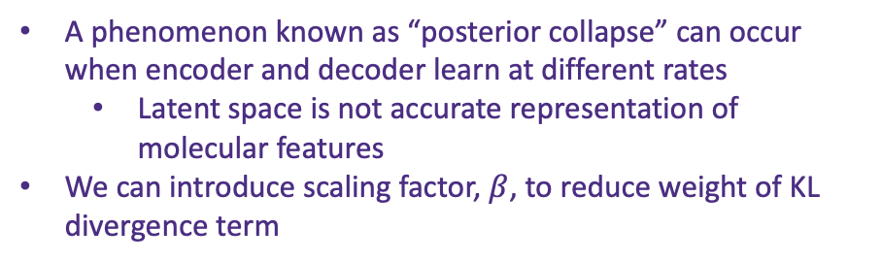
Evaluating the Loss Function
$$Loss=Reconstruction+KL Divergence+Property Prediction$$
Decoder
Reconstructed
SMILES
Encoder
SMILES
Backpropagation
*
KL divergence loss calculated
*
Reconstruction loss calculated
A phenomenon known as “posterior collapse” can occur when encoder and decoder learn at different rates
Latent space is not accurate representation of molecular features
We can introduce scaling factor, $β$, to reduce weight of KL divergence term

Slide 18
Evaluating the Loss Function
Effect of beta on model performance
$$Loss=Reconstruction+KL Divergence+Property Prediction$$
Decoder
Reconstructed
SMILES
Encoder
SMILES
Backpropagation
*
KL divergence loss calculated
*
Reconstruction loss calculated
A phenomenon known as “posterior collapse” can occur when encoder and decoder learn at different rates
Latent space is not accurate representation of molecular features
We can introduce scaling factor, $β$, to reduce weight of KL divergence term

Slide 19
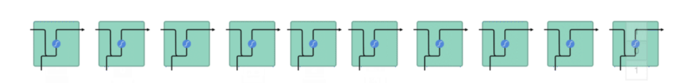
Choosing a Model Architecture
Convolution (Encoder)
Gated Recurrent Unit
C C ( Br )

Slide 20
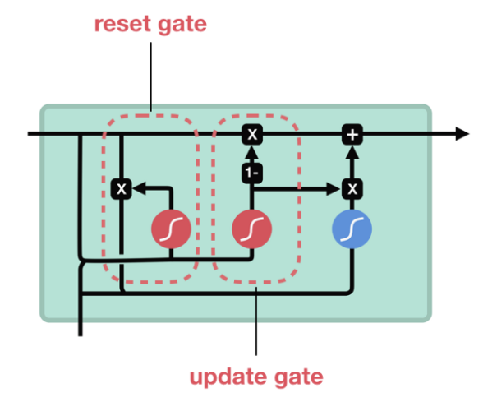
Choosing a Model Architecture
Convolution (Encoder)
Gated Recurrent Unit
(Encoder/Decoder)
C C ( Br )

Slide 21
Choosing a Model Architecture
We test a variety of encoder/decoder combinations
Conv – 3 convolutional layers
GRU – 3 gated recurrent units
biGRU – 3 bidirectional gated recurrent units
We want to optimize the accuracy with the fewest number of parameters

Slide 22
Choosing a Model Architecture
Effect of architecture on model performance
We test a variety of encoder/decoder combinations
Conv – 3 convolutional layers
GRU – 3 gated recurrent units
biGRU – 3 bidirectional gated recurrent units
We want to optimize the accuracy with the fewest number of parameters

Slide 23
What’s Next?
Pretrain on large GDB dataset and then train on plasticizers/organic molecules
Similar procedure as used in natural language processing applications such as machine translation
Attach property predictor to latent space
Simple fully connected neural net
Continue to improve understanding of desired plasticizer properties
Sample from trained latent space to generate new targets

